Slide 1
Digital Portfolio
STUDENT NAME: Dharshini p
REGISTER NO AND NMID:35524U09009/DA9D26F12E5E00BBF7F479E7F6C83B4E
DEPARTMENT: II-BCA
COLLEGE:Goverment Arts And Science College Tirupattur-635901

Slide 2
PROJECT TITLE
Student Digital Portfolio Using Networking And Security

Slide 3


AGENDA
Problem Statement
Project Overview
End Users
Tools and Technologies
Portfolio design and Layout
Features and Functionality
Results and Screenshots
Conclusion
Github Link
3/21/2024 Annual Review

Slide 4

PROBLEM STATEMENT
1. Weak security controls, leaving them vulnerable to cyber threats like unauthorized access, malware, denial-of-service (DoS) attacks, and data breaches. 2. Lack of monitoring and incident response, which delays detection of threats and compromises system availability. 3. Non-compliance with security standards and policies, risking legal and financial penalties.

Slide 5

PROJECT OVERVIEW
1. Design and implement a scalable network topology.
2. Configure routing, switching, VLANs, and subnets for efficiency.
3. Ensure redundancy, fault tolerance, and optimized performance.

Slide 6

WHO ARE THE END USERS?
1. Needs: Email, file shares, web apps, VoIP, printing.
2. Security concerns: Phishing, credential theft, data leakage.
3. Controls: MFA, SSO, endpoint protection, DLP, phishing training.

Slide 7

TOOLS AND TECHNIQUES
1. Purpose: deep diagnostics, investigating incidents. Techniques: full packet capture, targeted tcpdump traces, protocol decoding.
2. Tools: Wireshark, tcpdump, tshark, Zeek (formerly Bro) for network metadata.
3. When to use: root-cause of outages, forensic network investigations, protocol debugging.

Slide 8
POTFOLIO DESIGN AND LAYOUT
1. Skills & Tools (icon grid): routing, firewall, SIEM, EDR, cloud, etc. 2. Certifications & Education (badges): CCNA/CCNP, CISSP, CEH, OSCP, AWS. 3. Demos & Artifacts: links to GitHub labs, Packet Tracer/GNS3 files, videos, Kibana dashboards.
8

Slide 9
FEATURES AND FUNCTIONALITY
1. MPLS, Internet VPN, SD-WAN policies, dynamic path selection. 2. Functionality: WAN optimization, application-aware routing, SLA-based tie-breaking.

Slide 10

RESULTS AND SCREENSHOTS
1. protecting networks from threats to ensure confidentiality,
2. integrity, and availability of data and systems through strategies like firewalls,
3.intrusion prevention systems, and network segmentation.
3/21/2024 Annual Review
10

Slide 11
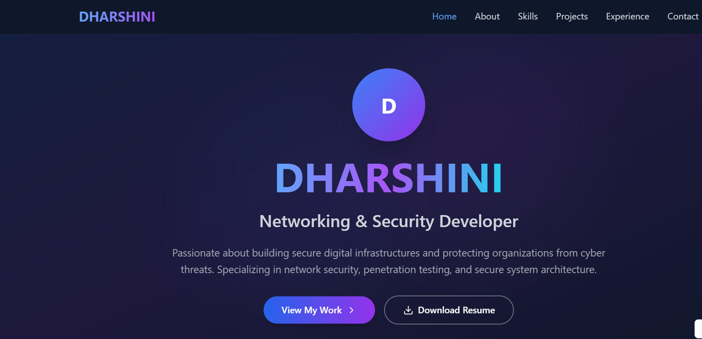

Slide 12
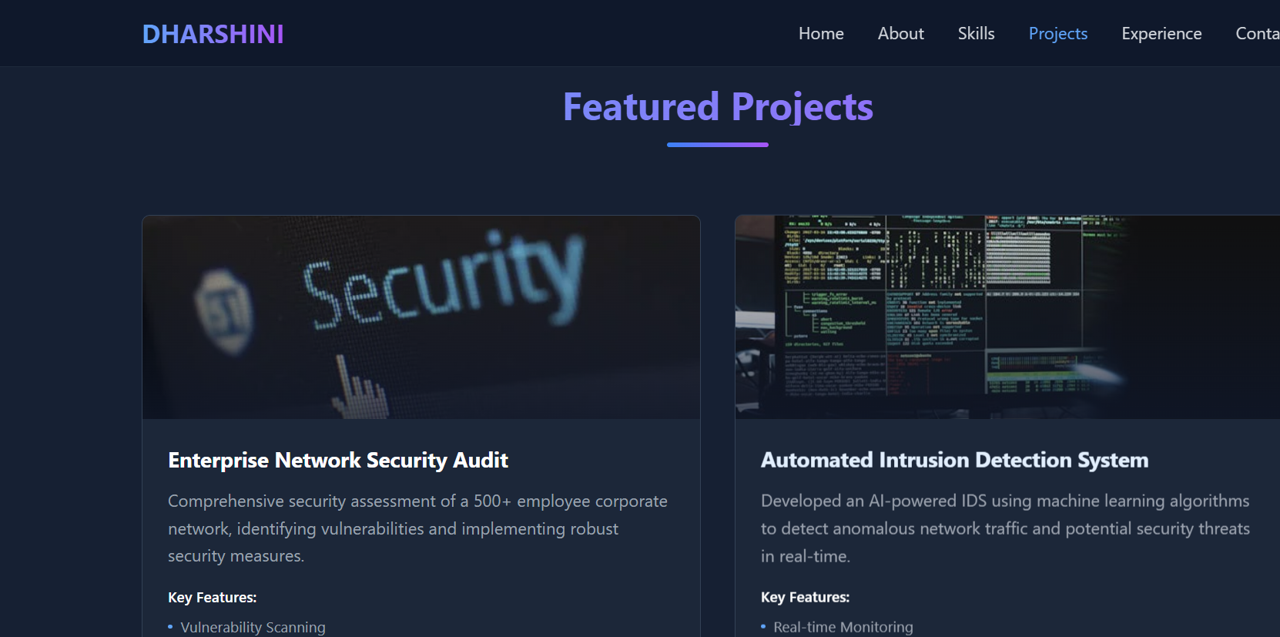
12

Slide 13
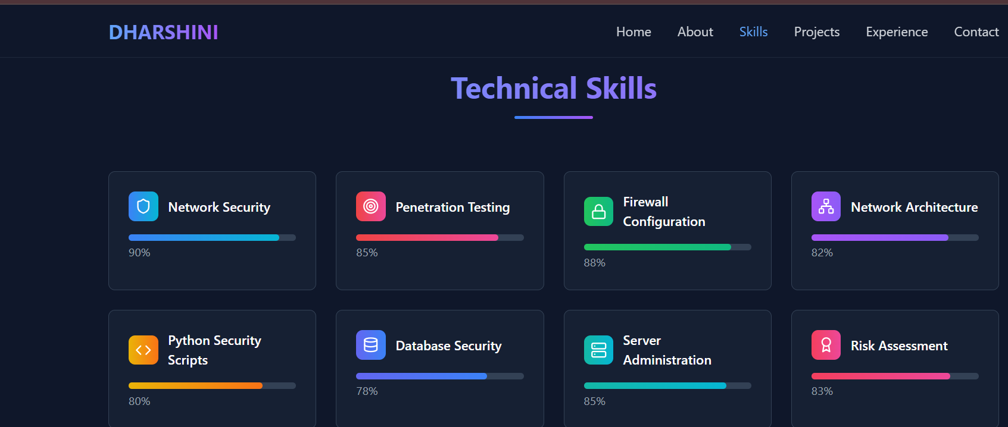

Slide 14
Conclusion
1. robust network security is essential in our hyper-connected world to protect data, ensure operational continuity, and maintain trust
2. requiring a comprehensive, multi-layered approach including technical solutions like encryption and firewalls,
3. strategic planning through defense-in-depth and user education,

Slide 15
GITHUB
https://github.com/DHARSHINIGASCTPT/NMDHARSHINI2025.git

